Slide 1
Hibernate L1 Cache

Slide 2
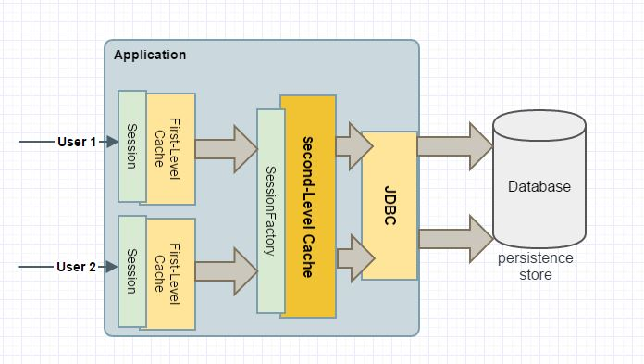
Hibernate Cache Overview

Slide 3
First-level Cache Scope
The first-level cache is session-scoped
The Hibernate session is the main runtime interface between a Java application and Hibernate.
The main function of the Session is to offer create, read and delete operations for instances of mapped entity classes.
Instances may exist in transient, persistent or detached state.
The lifecycle of a Session is bounded by the beginning and end of a logical transaction.
Each session has its own first-level cache

Slide 4
How does it improve performance?
When we query an entity the first time, it is retrieved from the database and stored in the first-level cache associated with the current hibernate session. If we query the same object again within the same session, it will be loaded from the cache and no sql query will be executed.
The entity is not immediately synchonized with the database when an object is created, updated or removed, but only when the flush() method is executed.

Slide 5
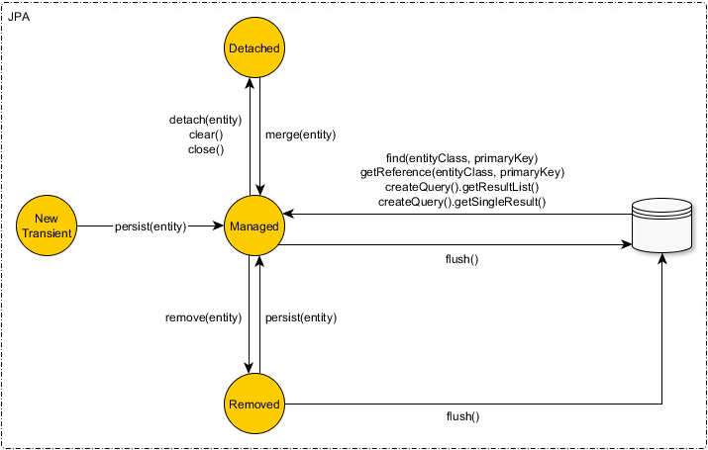
State of Objects in JPA/Hibernate

Slide 6
Important notes
The first-level cache is enabled by default and you cannot disable it.
It cannot be accessed by other sessions.
It is not thread-safe.
Batching too many SQL statements at flush time might lead to memory issues.
Since the first-level cache is limited to the session, it discards the object upon session completion.

